Slide 1
STAT 578 – FALL 2019 Paper Presentation
Eric Ellwanger

Slide 2
Towards measles elimination in Italy:
Monitoring herd immunity by Bayesian mixture modelling of serological data
Publication: Epidemics, Volume 4 – Issue 3 (August 2012). Page 124-131
Authors:
Emanuele Del Fava
Ziv Shedky
Angela Bechini
Paolo Bonanni
Piero Manfreddi
Citation: Del Fava, E., Schedky, Z., Bechini, A., Bonanni, P., Manfreddi, P.(2012). Towards measles elimination in Italy: Monitoring herd immunity by Bayesian mixture modelling of serological data. Epidemics, 4 (3), 124-131.

Slide 3

Scientific Context
Italy started a National Measles Elimination Plan beginning in 2003.
Collect data to assess impact of the campaign (before and after campaign)
Serological data comprising $Log_{10}$Antibody count (in mIU/ml)
Age of individual

Slide 4
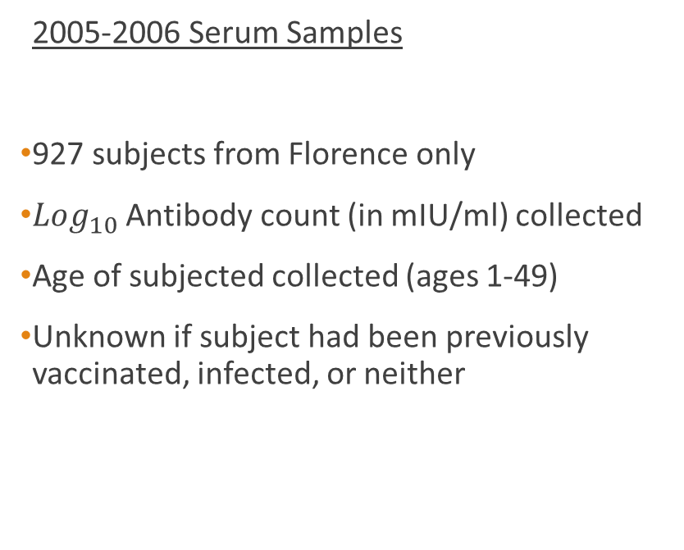
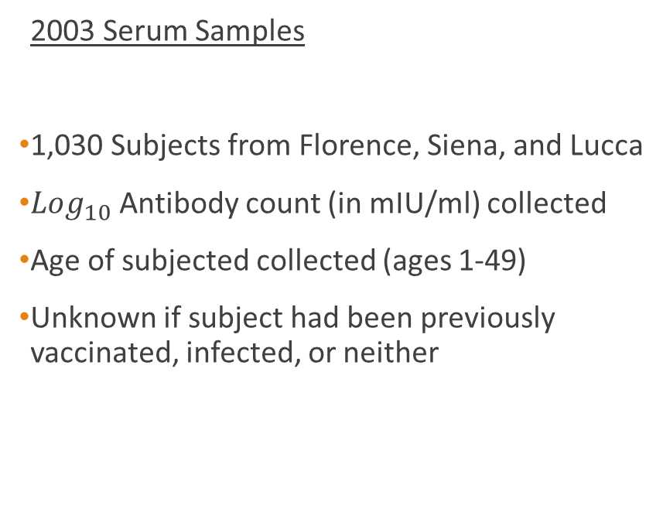
2003 Serum Samples
1,030 Subjects from Florence, Siena, and Lucca
$Log_{10}$Antibody count (in mIU/ml) collected
Age of subjected collected (ages 1-49)
Unknown if subject had been previously vaccinated, infected, or neither
2005-2006 Serum Samples
927 subjects from Florence only
$Log_{10}$ Antibody count (in mIU/ml) collected
Age of subjected collected (ages 1-49)
Unknown if subject had been previously vaccinated, infected, or neither

Slide 5
Research Question
Address issues of analyzing post-vaccination data to accurately show impact
Improve upon classical methods
Use conventional cut-off methods suggested by assay manufacturers
Target test specificity at the cost of test sensitivity
Ability to categorize (or classify) groups with differing levels of immunity
Using a Bayesian Normal Mixture model
Has been used effectively w/ other serological data
Estimate age-specific population prevalence based on the following assumptions:
1. Immunity is lifelong
2. Mortality caused by infection is negligible (so disregard)

Slide 6
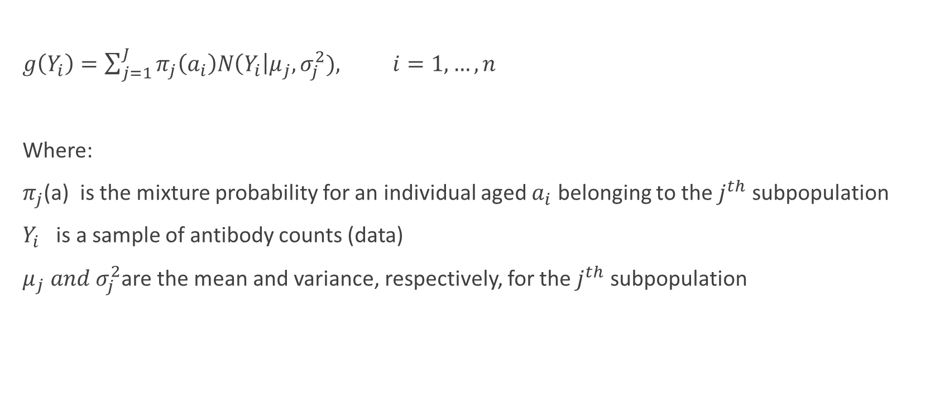
Proposed Age Dependent Model
$g\left(Y_{i}\right)=\sum_{j=1}^{J}{π_{j}\left(a_{i}\right)N\left(Y_{i}\right|μ_{j}, σ_{j}^{2}), i=1, …, n}$
Where:
$π_{j}$(a) is the mixture probability for an individual aged $a_{i}$ belonging to the $j^{th}$ subpopulation
$Y_{i}$ is a sample of antibody counts (data)
$μ_{j} and σ_{j}^{2}$are the mean and variance, respectively, for the $j^{th}$ subpopulation

Slide 7
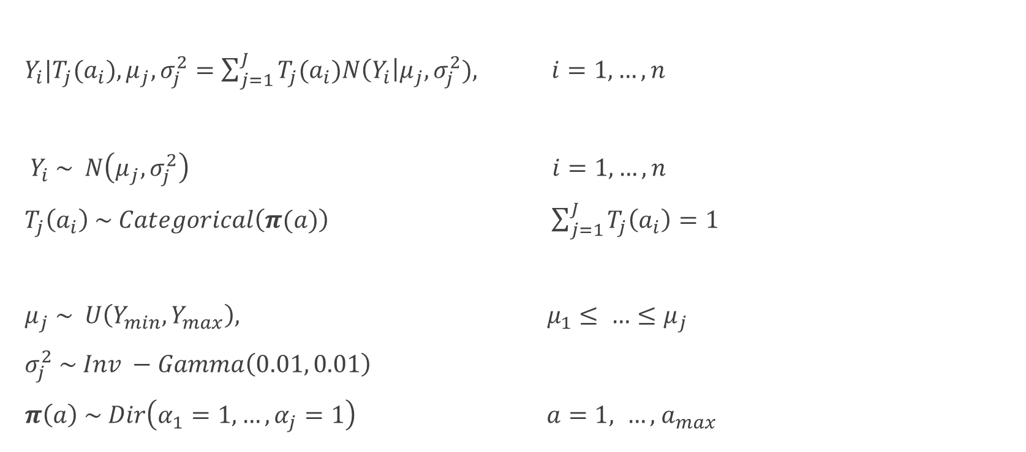
Mathematical Description of Model
$Y_{i}|T_{j}(a_{i}), μ_{j}, σ_{j}^{2}=\sum_{j=1}^{J}{T_{j}(a_{i})N\left(Y_{i}\right|μ_{j}, σ_{j}^{2}), i=1, …, n}$
$Y_{i} \sim N\left(μ_{j},σ_{j}^{2}\right) i=1, …, n$
$T_{j}\left(a_{i}\right) \sim Categorical\left(π(a)\right) \sum_{j=1}^{J}{T_{j}\left(a_{i}\right)=1}$
$μ_{j} \sim U\left(Y_{min}, Y_{max}\right), { μ}_{1}≤ …≤μ_{j}$
$σ_{j}^{2} \sim Inv −Gamma\left(0.01, 0.01\right)$
$π\left(a\right) \sim Dir\left(α_{1}=1, …, α_{j}=1\right) a=1, …, { a}_{max}$

Slide 8
MCMC Details
JAGS Software, version 3.1
Modeled each model parameter to obtain it’s posterior density to summarize:
Posterior mean
95% credible interval
Selection of number of components (j):
Ran models for different age dependent mixture models with between 3-6 components
Used PED – Penalized Expected Deviance – to choose best model (similar to DIC)
Found 3 components for 2003 data worked best
Found 4 components for 2005-2006 data worked best

Slide 9
Results
Data shows high antibody levels in young children under 5, lowest levels in subjects ages 10-20, and high levels again in subjects ages 25+
About a 5 year lag between the 2 sampling periods

Slide 10
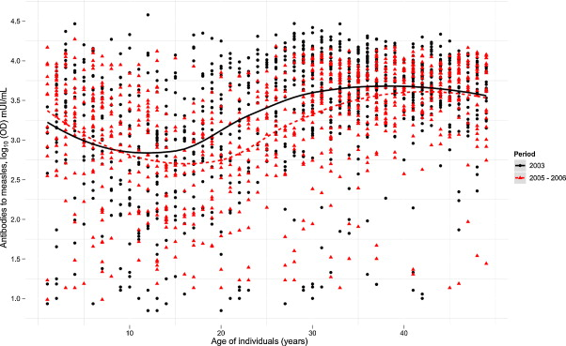
Del Fava, E., Schedky, Z., Bechini, A., Bonanni, P., Manfreddi, P.(2012). Towards measles elimination in Italy: Monitoring herd immunity by Bayesian mixture modelling of serological data. Epidemics, 4 (3), 124-131.

Slide 11
Results
Data shows high antibody levels in young children under 5, lowest levels in subjects ages 10-20, and high levels again in subjects ages 25+
About a 5 year lag between the 2 sampling periods
Fitted data shows 3 well defined clusters for the 2003 period, and 4 clusters for the 2005-2006 period.

Slide 12
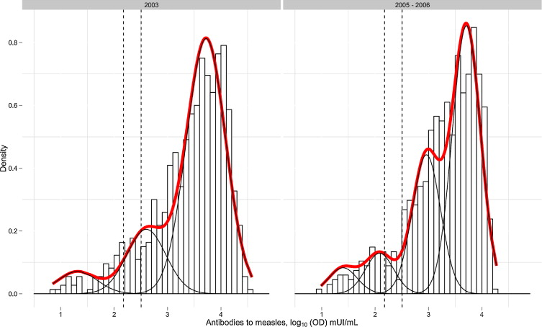
Del Fava, E., Schedky, Z., Bechini, A., Bonanni, P., Manfreddi, P.(2012). Towards measles elimination in Italy: Monitoring herd immunity by Bayesian mixture modelling of serological data. Epidemics, 4 (3), 124-131.

Slide 13
Results
Data shows high antibody levels in young children under 5, lowest levels in subjects ages 10-20, and high levels again in subjects ages 25+
About a 5 year lag between the 2 sampling periods
Fitted data shows 3 well defined clusters for the 2003 period, and 4 clusters for the 2005-2006 period.
Comparison of results with classical cut-off methods show higher proportion of susceptible subjects than the normal mixture model in 2003, assumedly due to the specificity of the assays. But, this does not hold for the 2005-2006 model.

Slide 14
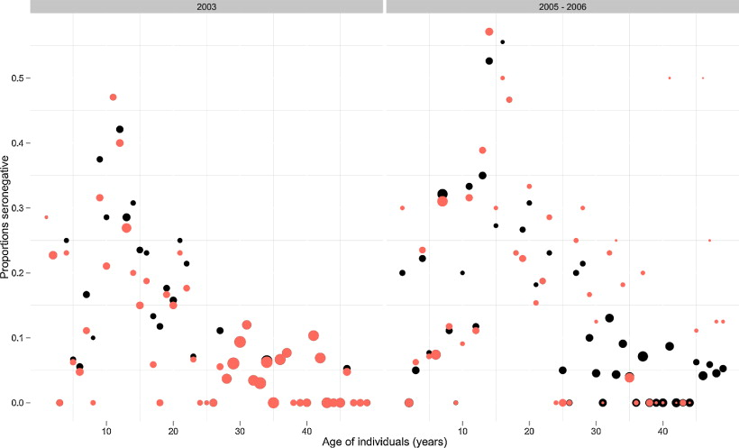
Del Fava, E., Schedky, Z., Bechini, A., Bonanni, P., Manfreddi, P.(2012). Towards measles elimination in Italy: Monitoring herd immunity by Bayesian mixture modelling of serological data. Epidemics, 4 (3), 124-131.

Slide 15
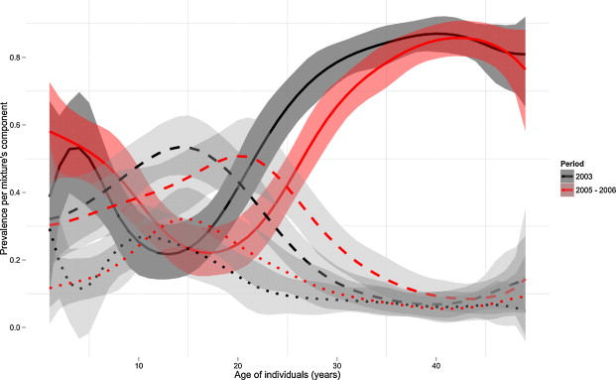
Del Fava, E., Schedky, Z., Bechini, A., Bonanni, P., Manfreddi, P.(2012). Towards measles elimination in Italy: Monitoring herd immunity by Bayesian mixture modelling of serological data. Epidemics, 4 (3), 124-131.

Slide 16
Issues
No mention of model diagnostics – i.e. convergence, normality checks, or outliers.
As authors note, better inferences could be made if additional data, such as previous infection or vaccination, were available.
Possible issue with 2006 data due to not coming from all of the same cities.

